Slide 1
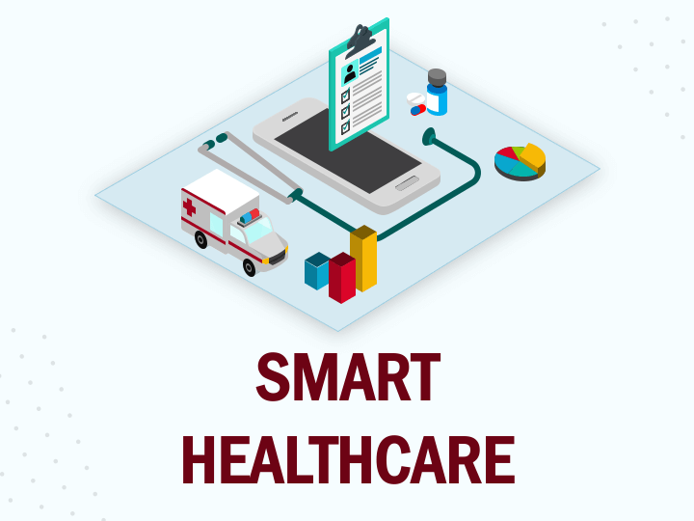
Telemedicine Web Application
A Digital Health Care Solutions
The Beginner’s

Slide 2
A Digital Health Care Solutions

Slide 3
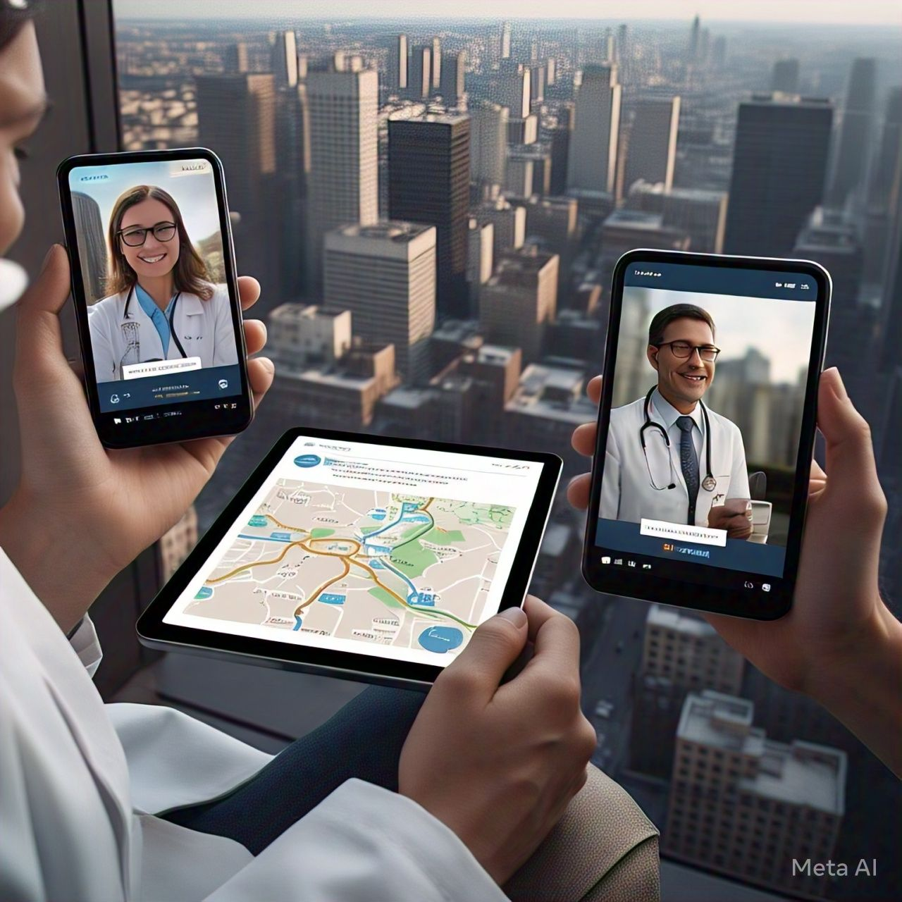
Introduction
What is Telemedicine ?
Telemedicine allows remote healthcare services using digital communication. Purpose of the Web Application Enables online consultations with doctors. Allows users to select specialists based on their medical issues . Provides a seamless and accessible healthcare experience.

Slide 4

Purpose of the Web Application
Enables online consultations with doctors. Allows users to select specialists based on their medical issues. Provides a seamless and accessible healthcare experience.

Slide 5
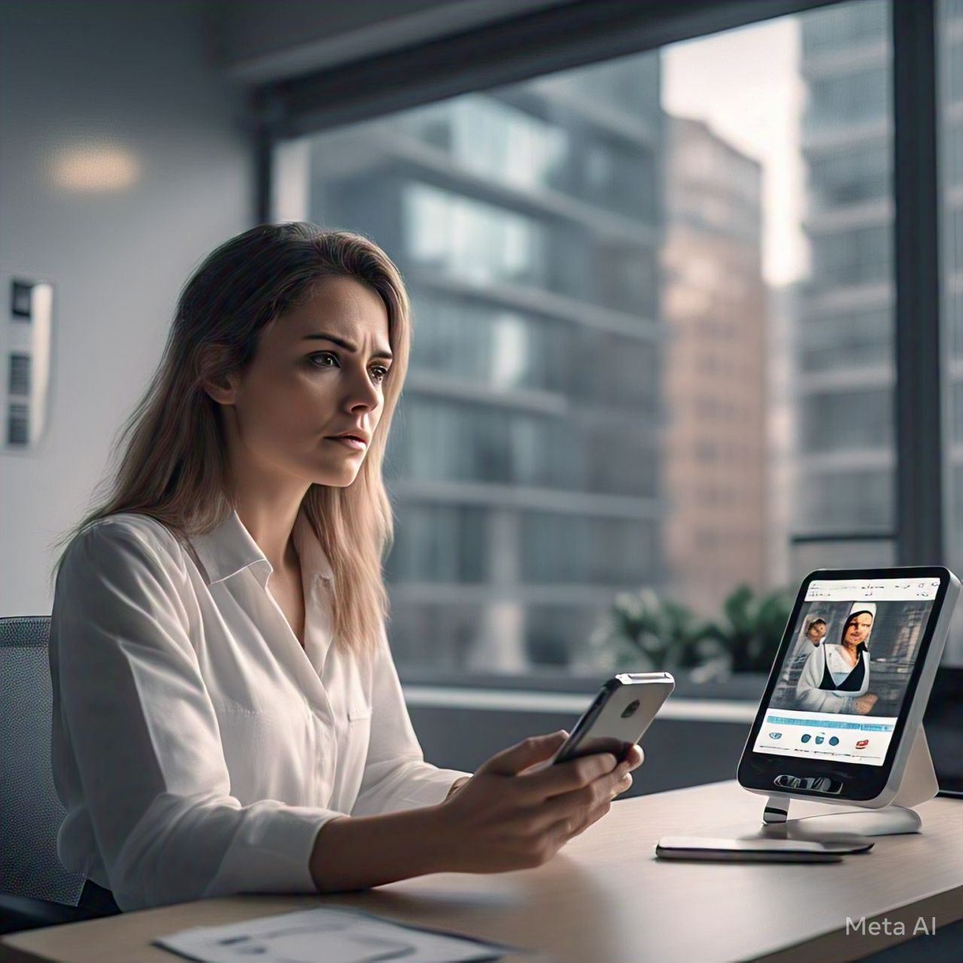
Problem Statement
Difficulty in accessing healthcare due to:
Geographical barriers Long waiting times in hospitals High consultation costs Need for a digital solution that bridges the gap between patients and doctors.

Slide 6
OBJECTIVES:-
Telemedicine Goals - Web Applications 1. Allow patients to consult with their doctor from anywhere. 2. Simple Doctor Choice - Allows users to choose a doctor for medical issues. 3. Secure user-certified patients and doctors ensure safe and private registration. 4. Samlos appointments - Simply talk to your patients and plan them. 5. Critical communication activates WhatsApp or chat-based interactions between physicians and patients.

Slide 7
6. Adjust Medical Documents - Regulation and Consulting History. 7. Reduce health barriers - Minimize hospital travel and waiting times. 8. Improve medical availability - Optimize physician planning for efficient services. 9. Improve patient experience A user-friendly and responsive interface. 10. Make sure data security protects patient information with secure protocol

Slide 8
Features
1. Service Orientation 2. Empathy and compassion
3. Diligent work 4. Passion for the field 5. Powerful communication skills
6. He is knowledgeable

Slide 9

Technology Stack
FrontEnd: HTML, CSS, JavaScript,
Bootstrap Backend: php datenbank: mysql

Slide 10
System Architecture
User Interface (Website) Database (User and Doctor Information) PHP -Backend -Panel (Targeted Enquiries) Consultation

Slide 11
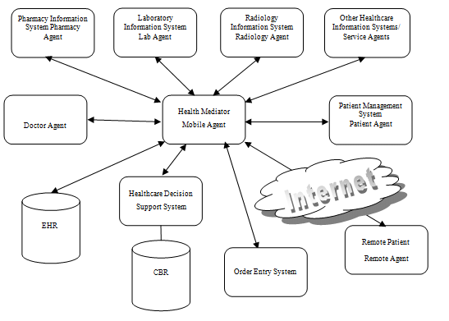

Slide 12
Workflow Diagram
1. User registration/login. 2. Select a doctor using the question. 3. Please make a reservation. 4. Doctors are accepted and advise online. 5. Recipes and follow-up advice are provided.

Slide 13
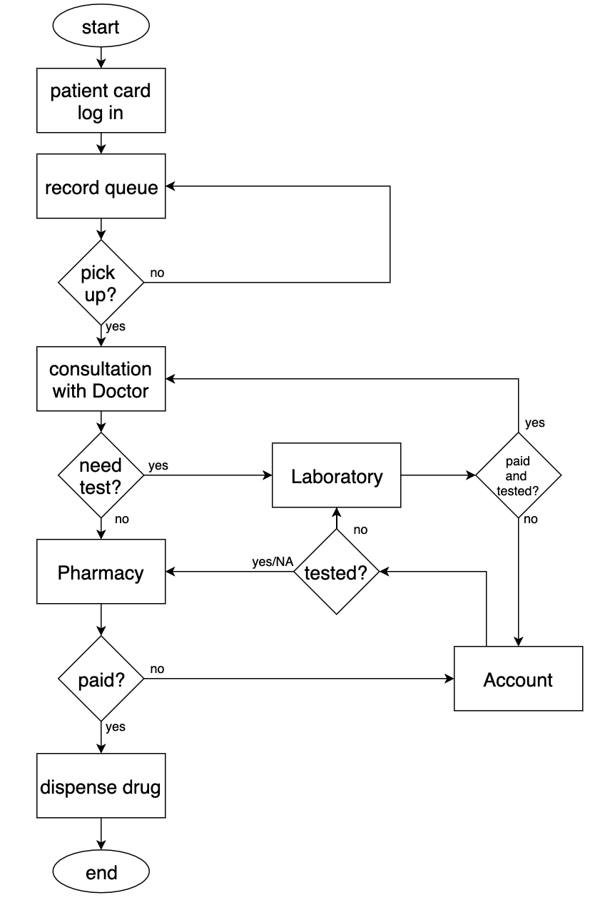

Slide 14
Benefits of the Application
Comfortable and Time - Access to affordable healthcare reduces hospital safe and efficient communication in hospitals

Slide 15
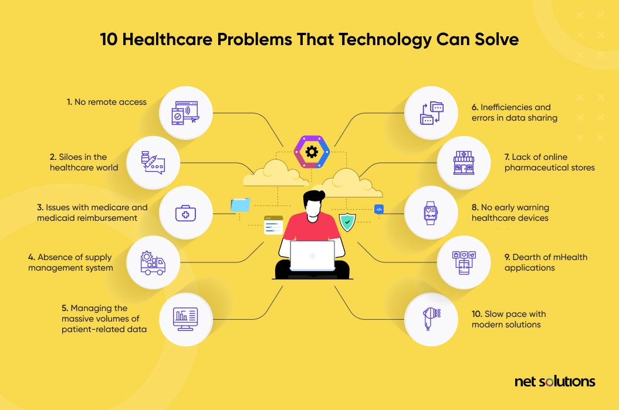

Slide 16
Challenges & Future Enhancements
Challenges: Ensuring data protection and security improvements for future improvements: Integrating AI-based symptom testing in multilingual support from wearable health devices.

Slide 17
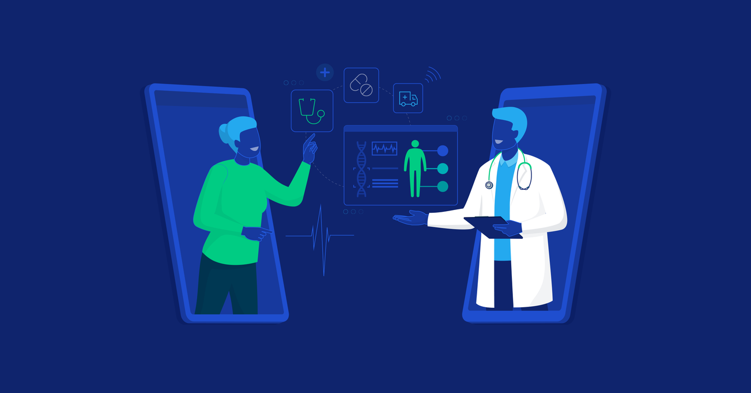

Slide 18
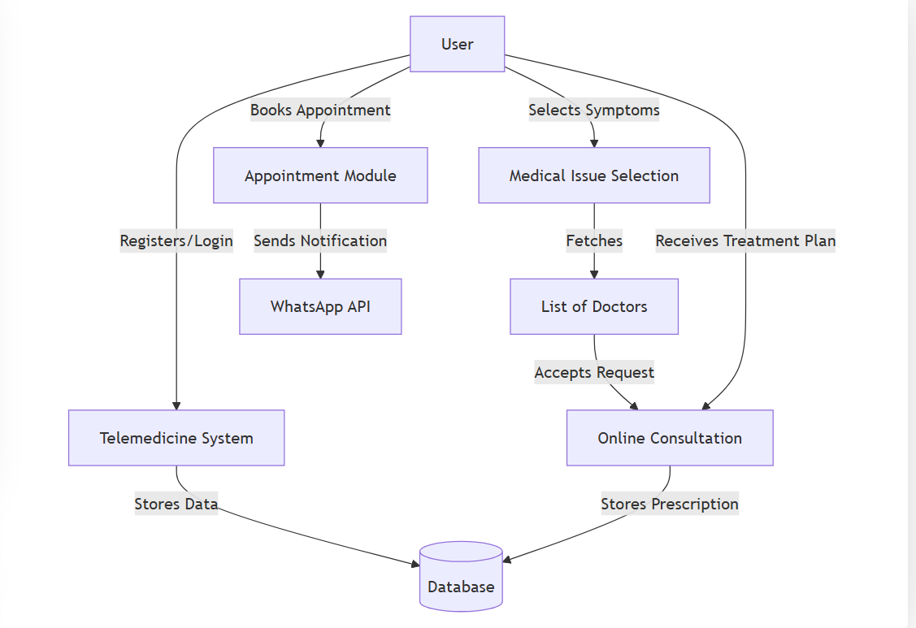
DFD

Slide 19
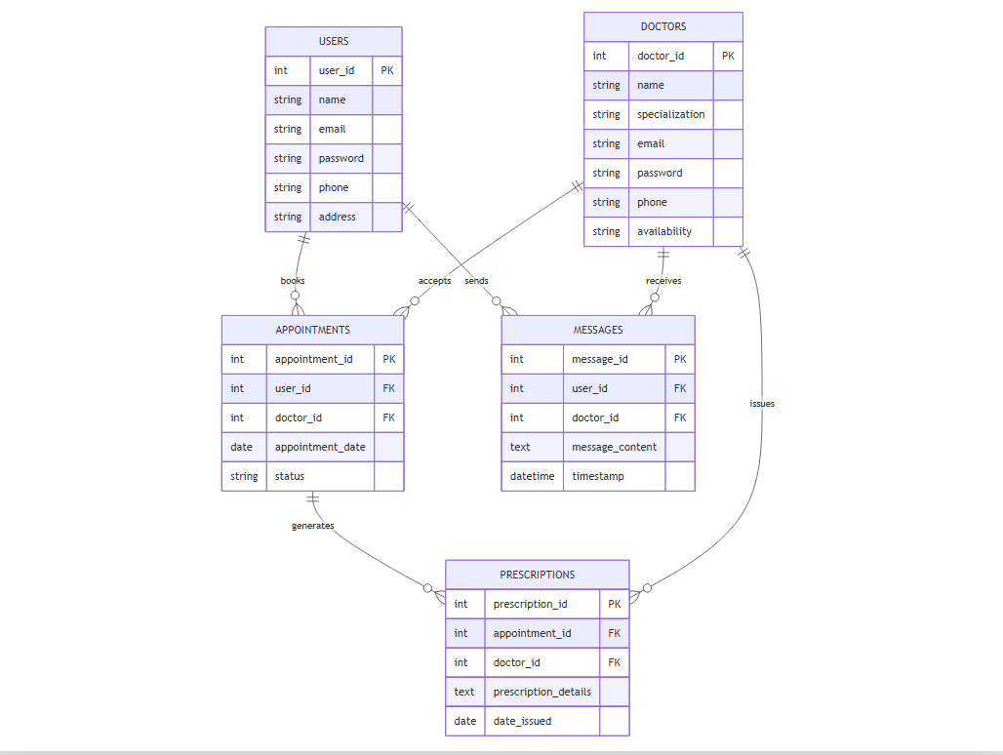
ER

Slide 20
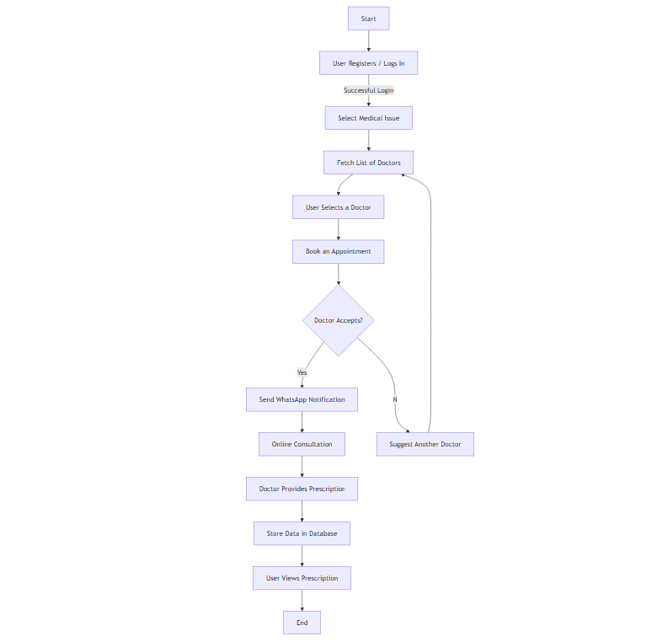
FLOW CHART

Slide 21
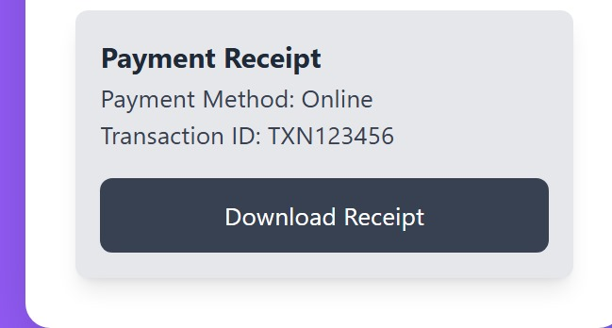
Receipt (Gateway-Payment)

Slide 22
Conclusion
Telemedicine is a modern-day healthcare player. Our web applications improve access, efficiency and patient physician interactions. Future improvements will be more intelligent and user-friendly.

Slide 23


